Slide 1
Welcome to Psychology Club & PSI CHI!
October 22nd, 2019
Notes:
7-12 people minimum October 26
interest form
bring friends
contact for discount with the number from the meeting
fear and anxiety lecture + dan in a costume

Slide 3
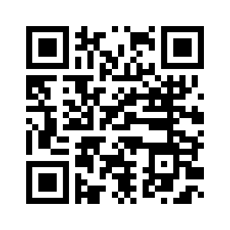
FOLLOW US!
Notes:
Go over events we have done in the past

Slide 4
PSI CHI - INTERNATIONAL PSYCHOLOGY HONORARY
Must be at least in the second semester of your sophomore year
Hold a 3.2 Psychology GPA
Hold a 3.0 Overall GPA
Complete at least 9
Psychology credit hours
Have an overall GPA in the top 35% of your class rank
Notes:
TASSO

Slide 5
PSI CHI Updates
Graduating in December?
Stole order form DUE November 1st
Winter Induction/Appreciation Dinner
TBD
Psi Chi Member of the Month….?
Notes:
TASSO

Slide 6
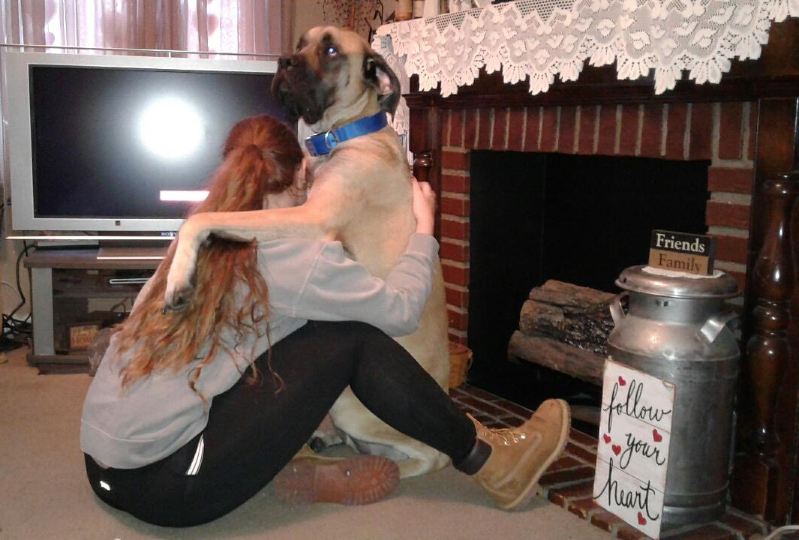
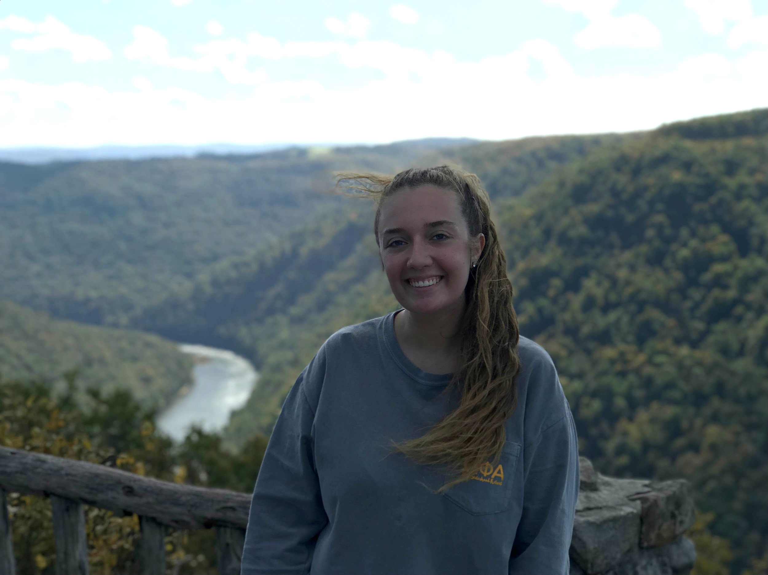
PSI CHI Member of the Month
Maddie Carroll
Notes:
TASSO

Slide 7
PSI CHI Member of the Month
Maddie Carroll
Senior Psychology and Political Science Double Major in the Honors College
Promotions Chair of Omega Phi Alpha
Only Service Sorority at WVU
Social Media Chair for UNICEF
Member of Mortar Board and Planned Parenthood Generation Action
Notes:
160 lb Mastif named Titan
Law School in the Fall

Slide 8
Think you could be Psi Chi Member of the Month?
Email me :)
mfsimpson@mix.wvu.edu

Slide 9
ADVISOR MINUTE &
SPECIAL PRESENTATION
Dr. Dan McNeil

Slide 10
Meet the
Grad Student Panel
Robin Han, Clinical Child
Jamey Brumbaugh, Clinical
Jeff Hughes, Developmental
Chris O'Hearn, Behavioral Neuroscience

Slide 11
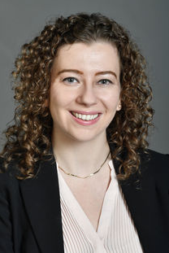
Advisor Workshop
Thanks for the scheduling Advice, Dr. Mick!

Slide 12
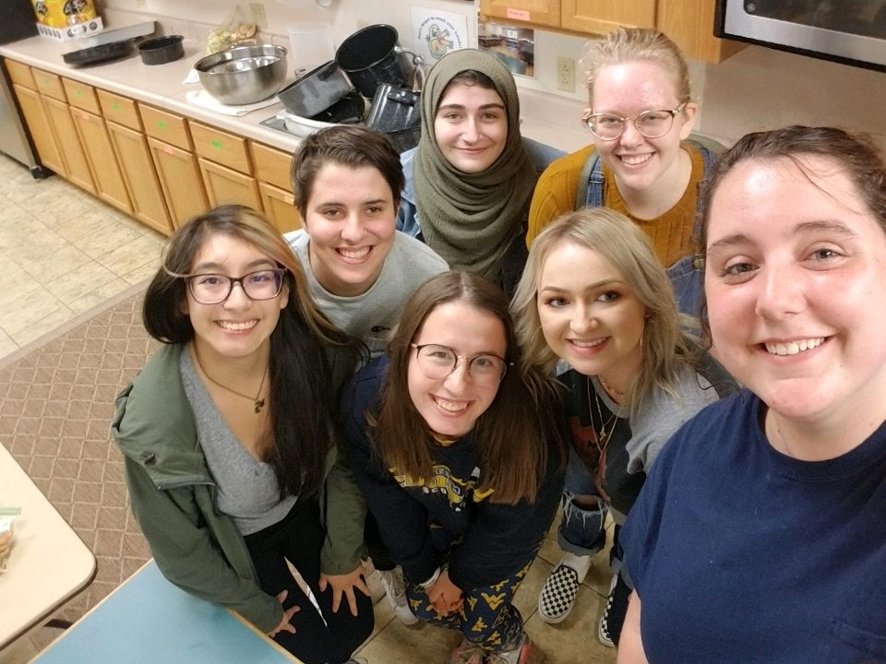
GRIEF CENTER DINNER
3
Carpool and earn service hours by cooking dinner for those who have suffered a recent loss
Thursday, Nov. 21
4:30-6:45 p.m.
Notes:
HATTIE

Slide 13
Feed the Brain Bake Sale
1
Wednesday, November 13 11-2 p.m.
LSB Lobby
1 Loyalty Point for donating individually wrapped baked goods
1 Loyalty Point for helping out

Slide 14
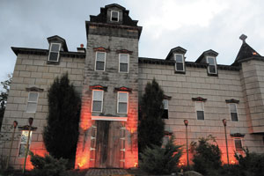
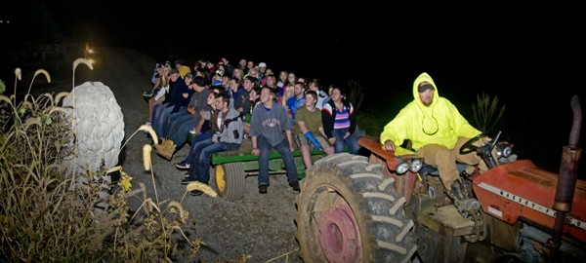
Fright Farm
2
$25 per person (Submit to office, mailbox, pizza sales…)
Invite your friends!
Need a ride? We are carpooling!
Tent site & campfire
Money is due today!
Friday, October 25th
Notes:
((( I will bring sign up sheet and can talk about it if you’d like @ Morgan))) - jeff

Slide 15
LOYALTY POINTS
What are they?
“Active Member” = 5 loyalty points each semester
You have one Loyalty Point right now!
You MUST be a member to receive Loyalty Points

Slide 16
LOYALTY POINTS
1 point = Attending a Psych Club/Psi Chi Meeting
1 point = Donating materials for Service Activities
1 point = Assisting with Pizza Sales
2 points = Recruit a friend to join (and pay dues) for Psych Club
2 points = Attend a Social event (no fee)
3 points = Attend Social event (fee)
3 points = Assist with Fundraising
3 points = Participate in a Service
Activity

Slide 17
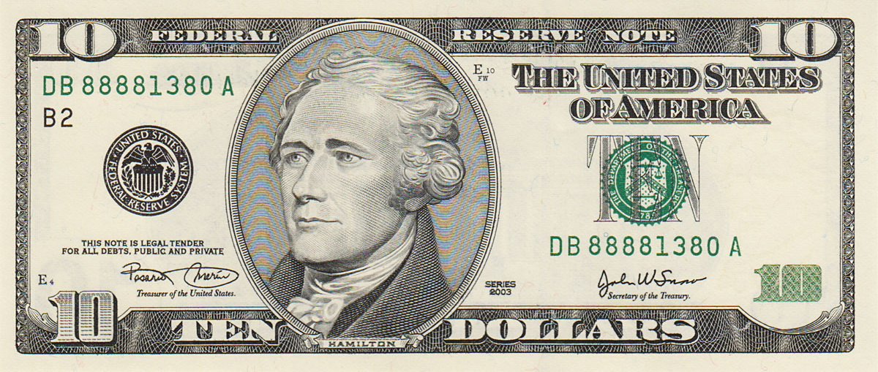
HOW TO JOIN
Submit an application and the $10 yearly dues
October 31st 🡪 Emails become restricted
Notes:
Even if you don’t have your dues with you, please fill out an application so we can get you on our mailing list and keep you in the loop!
AMNA

Slide 18
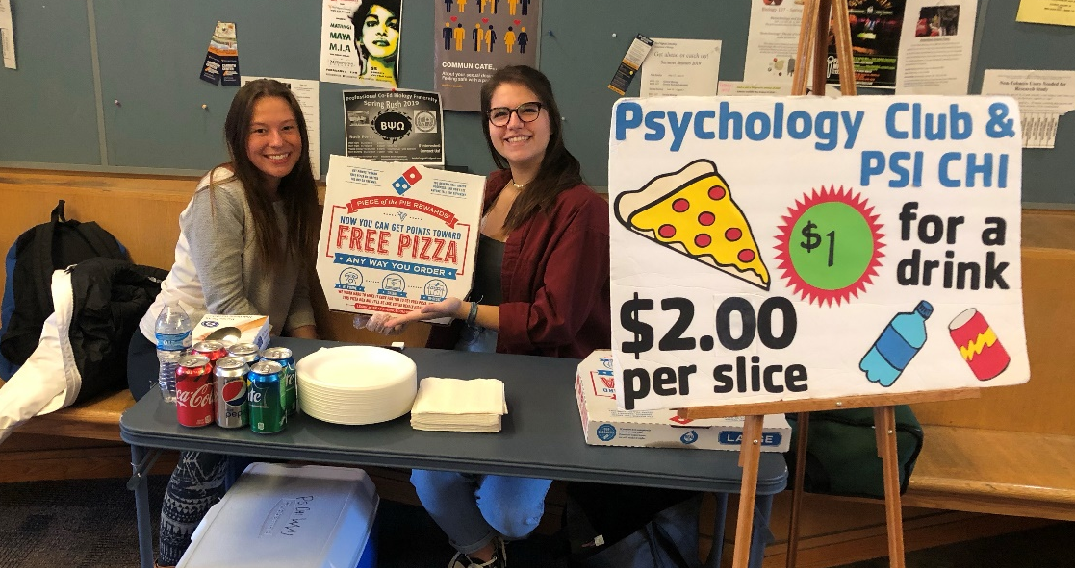
PIZZA SALES
1
Pizza sales are held every Wednesday in the LSB lobby!
11:15 am – 12:45 pm
Earn loyalty points & get free pizza by helping out!
Notes:
NATALIE

Slide 19
Wanted: Spring Pizza Person/Fundraising Chair
Must be available from 11 a.m.-12:45 p.m. on Wednesdays this Spring
Get leadership experience
Improve your resume
Get free pizza every week!

Slide 20
T-SHIRT

Slide 21
Due by November 19th (our next meeting)
Will be delivered during finals week
$15 Short Sleeve
$20 Long Sleeve
Notes:
buy more extras than last year

Slide 22
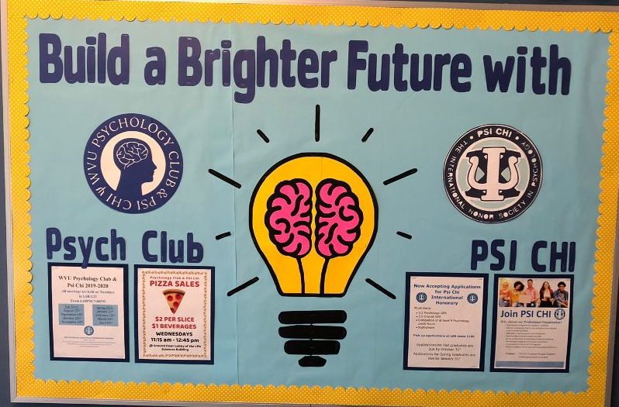
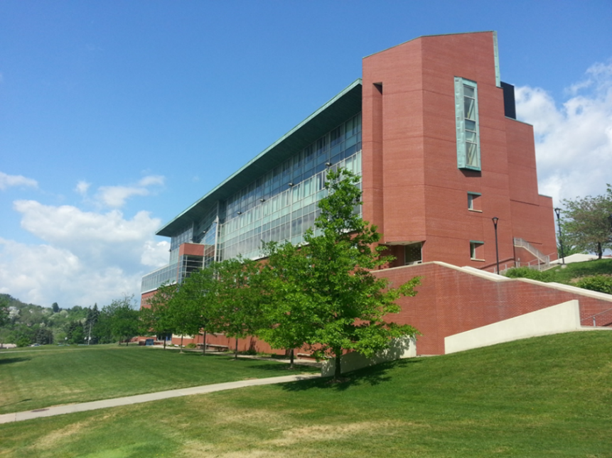
OFFICE HOURS
Hours posted outside club office
(Room 1106 LSB)
Notes:
slide that shows members our office hours and advertise that is officers can help them study. I suggest this because as a member of psych club my freshman and sophomore year I didn’t know why I would ever visit the officers during their hours. But if I was told I could possibly go and study with them I probably would have gone to some office hours considering it’s right beside the testing room.

Slide 23
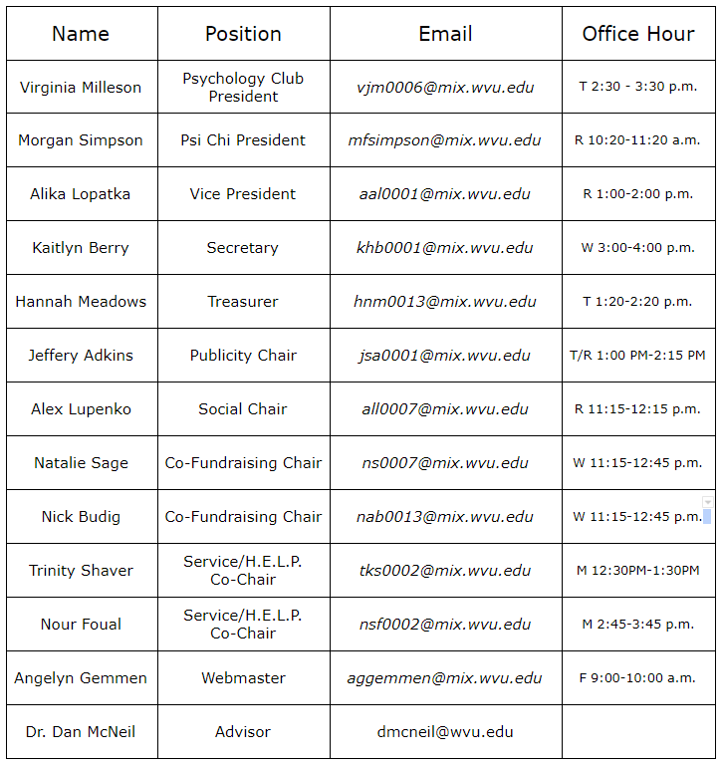

Slide 24
SUBMIT YOUR MEMBERSHIP FORM AND DUES

Slide 25
Let’s paint!
Grab some supplies and a beverage.
Paint the brain however you would
like to!
2
Notes:
Mention the emailed survey

Slide 26
THANK YOU FOR COMING!
See you at our next meeting!
November 19, 2019
6PM LSB-G21
Notes:
Mention the emailed survey

